Slide 1
Happy Apple
Nourhan ElFaramawy , Ahmed Saleh , Ali Saleh , Stefan Thomas

Slide 2
Main Idea and Fallacies
Taking a positive approach in live helps you look younger
Fallacies
People & apples have similar water content so they are experimentally equivalent
Dr.Masaru have never published details of his work just end result
Making part of the body happy (the water content) doesn’t lead to a beautiful body
Only good words are enough for a positive approach

Slide 3
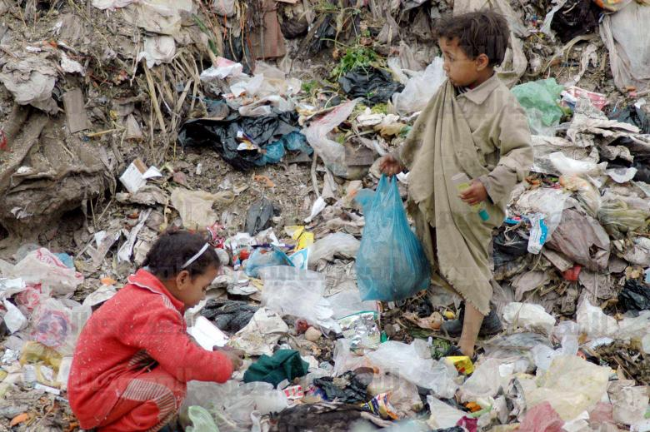

Slide 4
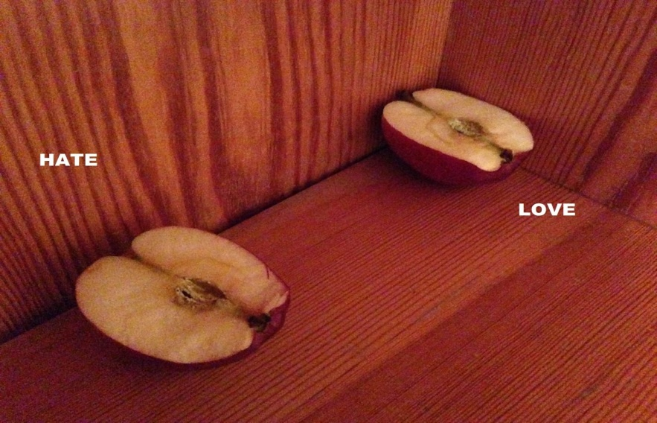
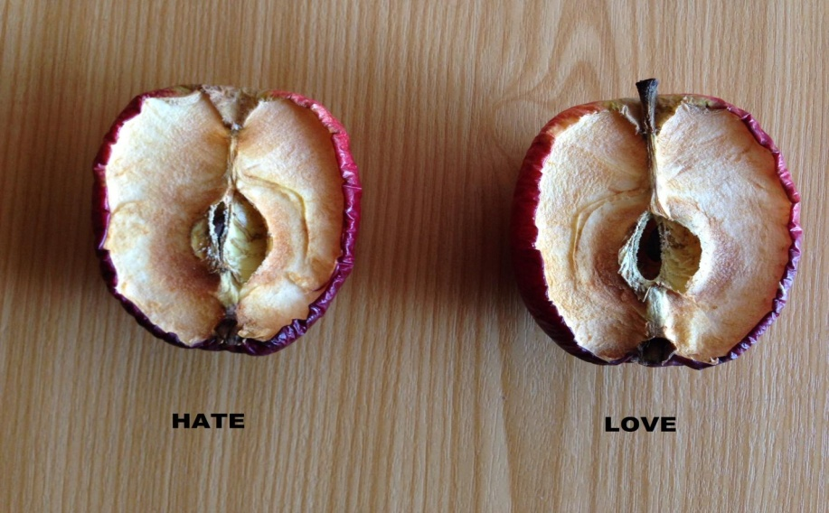
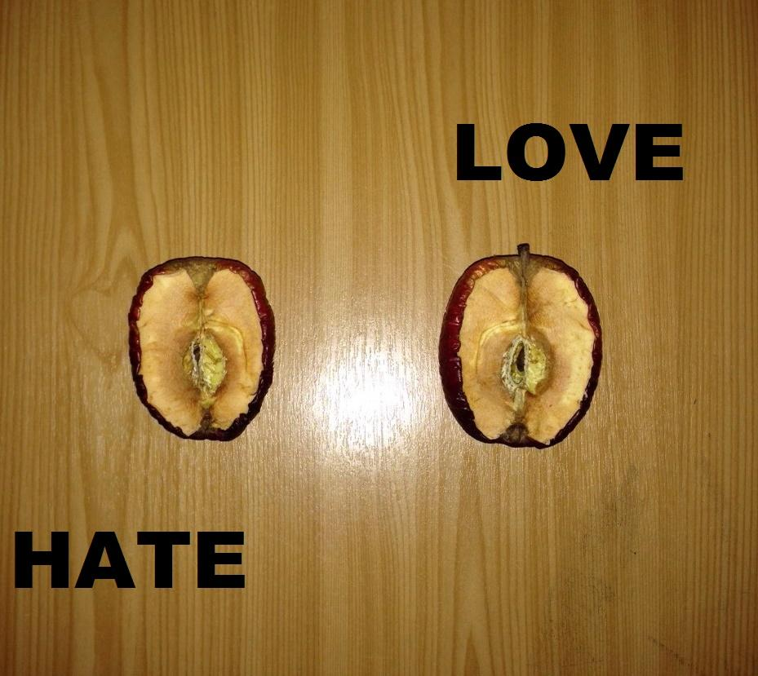
Placebo Effect

Slide 5
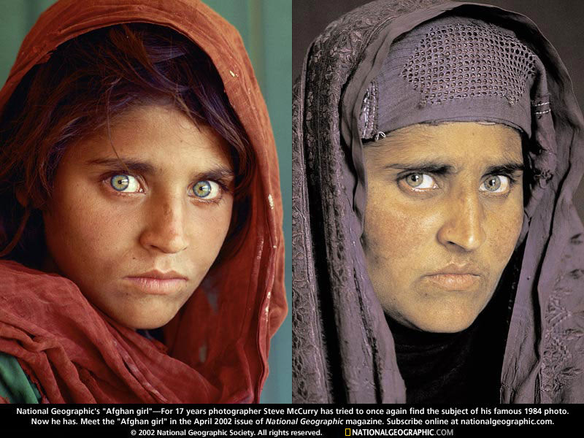

Slide 6
